Slide 1

Predict Sentiments on COVID-19 Tweets
By
Jahnavi Patchipalu & Wen Yuan

Slide 2
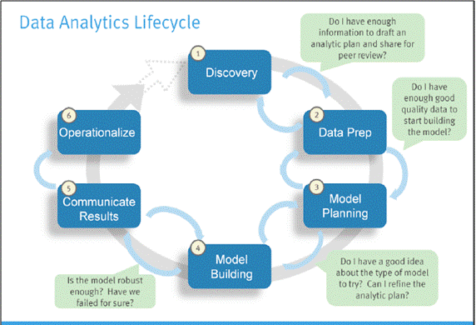
Data Lifecycle
Contents:
Problem Statement
Data Preparation
Exploratory Data Analysis
Text Analysis
Model Building
Logistic Regression
Decision Tree
Naïve Bayes
Association rules
Apriori Algorithm
Data Visualizations
Results/Conclusion

Slide 3

Problem Statement
To build classification models for predicting the sentiments of COVID-19 Twitter tweets.
To Predict whether the tweet is positive tweet(yes) or negative(no).

Slide 4
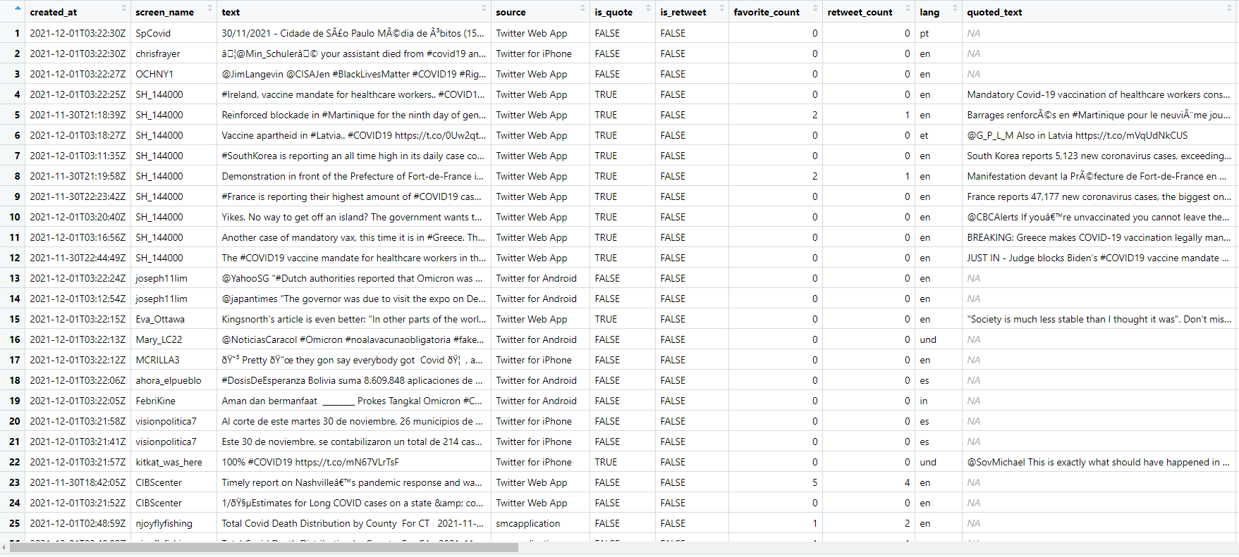
Data Preparation
The data set(covid19_tweets.csv) contains 100,000-observations and 90-variables

Slide 5
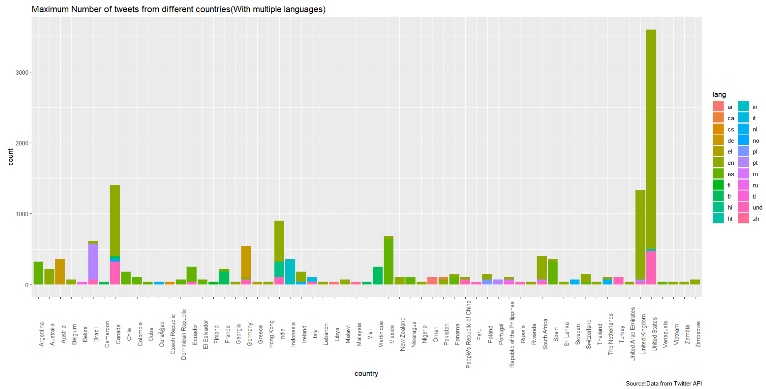
Exploratory Data Analysis
Maximum Number of tweets from different countries

Slide 6
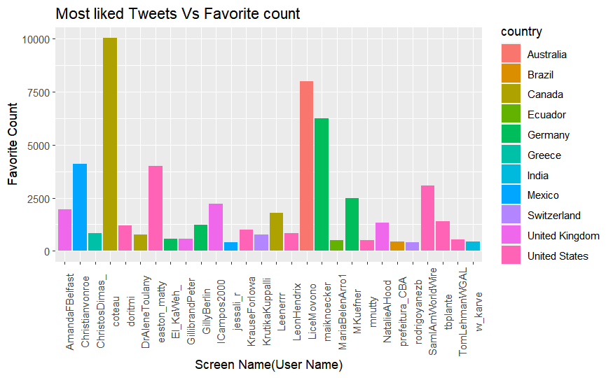
Most Liked Tweets from different countries

Slide 7
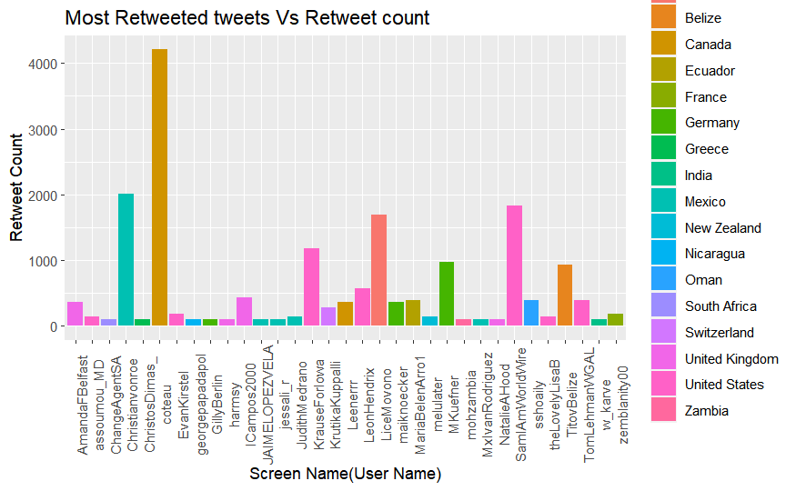
Most Retweeted Tweets from different countries

Slide 8
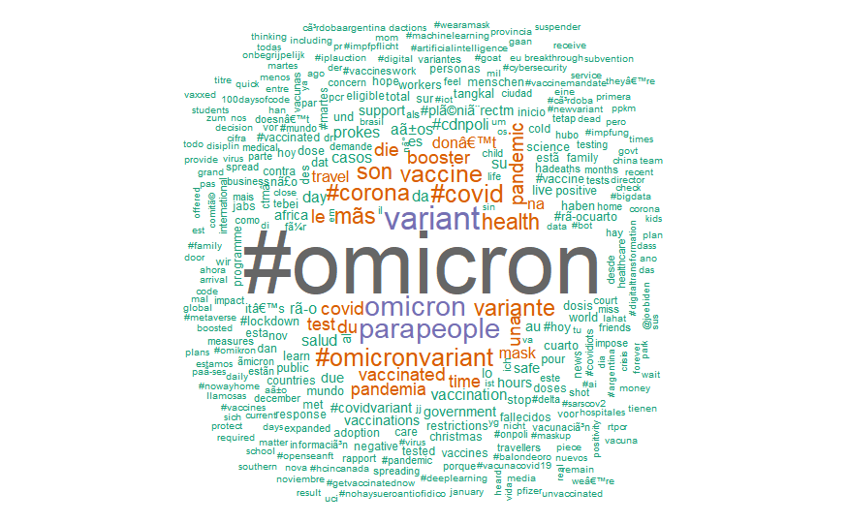
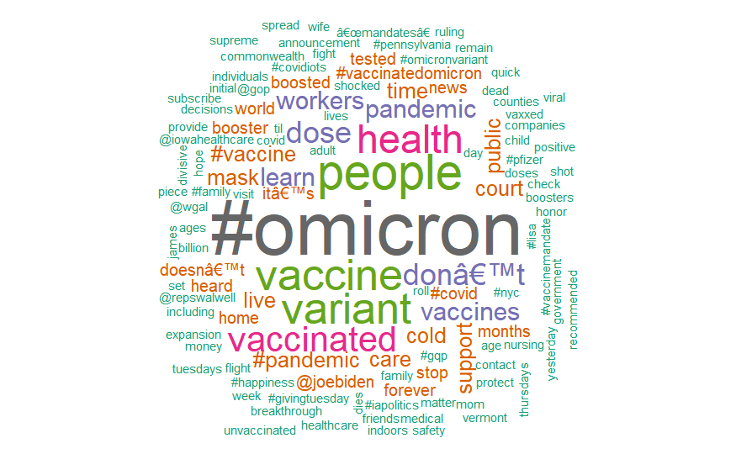
Text Analysis
Top 10-word frequency
Top 10 U.S tweets and word frequency

Slide 9
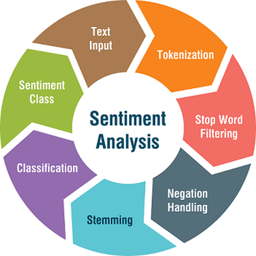
What is Sentiment Analysis?
The process of computationally identifying and categorizing opinions expressed in a piece of text, especially in order to determine whether the writer's attitude towards a particular topic, product, etc. is positive, negative, or neutral.

Slide 10
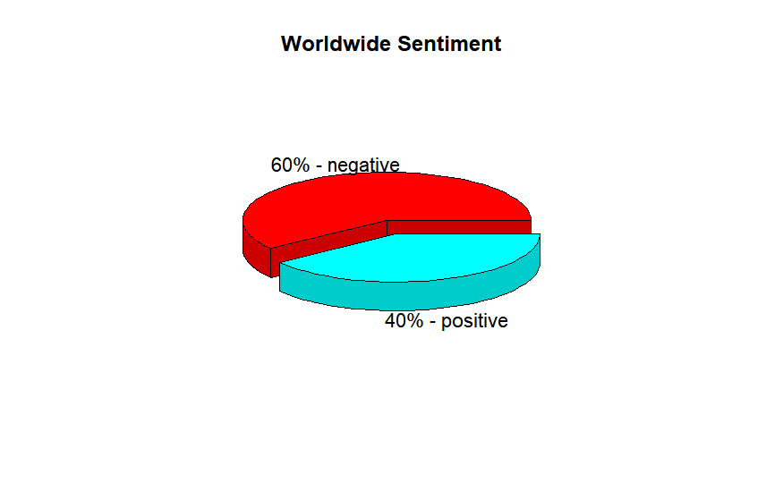
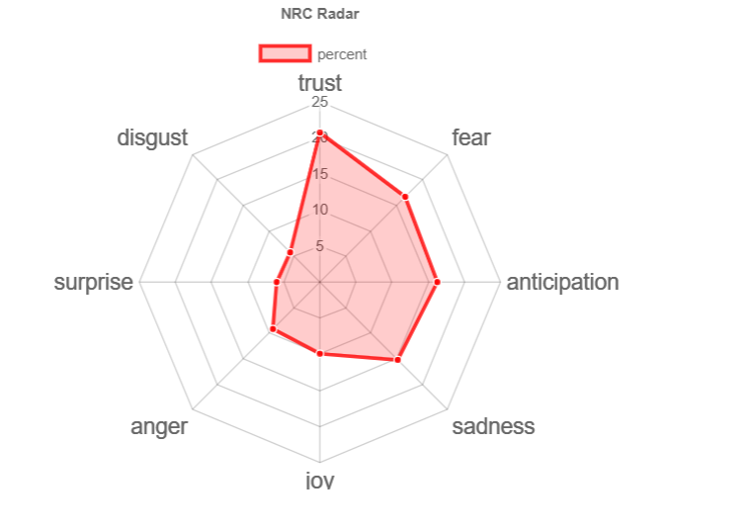
Radar Chart/Spider Plot : It is used to visualize the values over more than one quantitative variable.

Slide 11
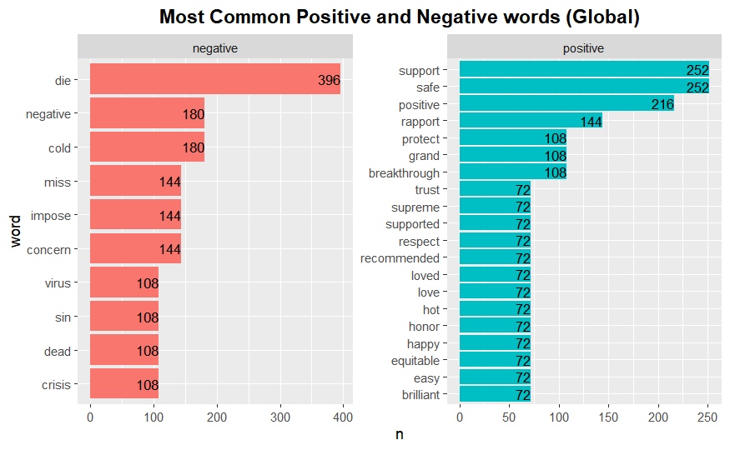
Most Common Positive and Negative Words

Slide 12
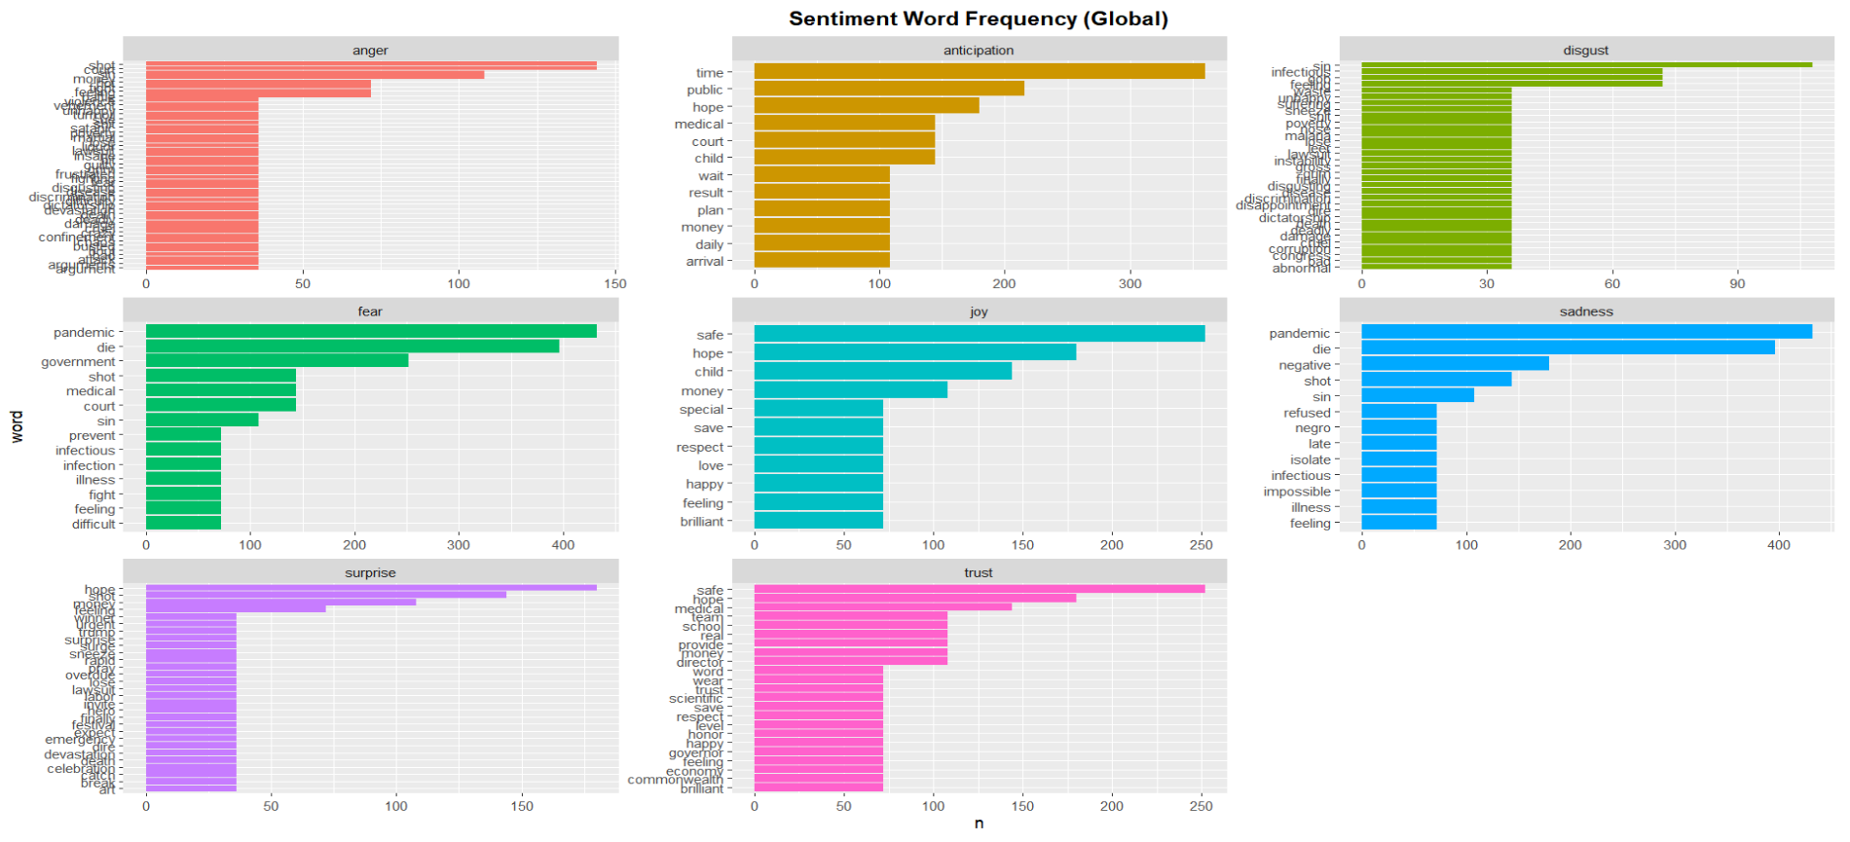
Sentiment Word Frequency

Slide 13
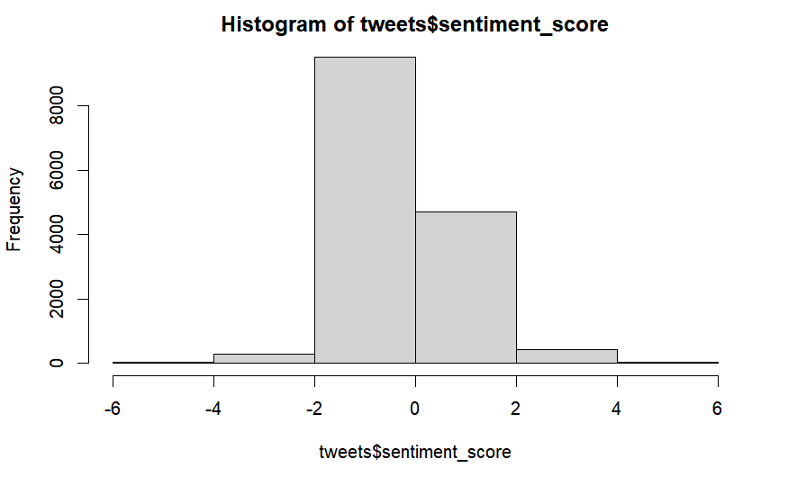
Sentiment Score

Slide 14
Model Building
Logistic Regression
Decision Tree(Ctree and Rpart)
Naïve Bayes
Classification models are used to predict whether the tweet is positive or negative
Created sentiment score for each text in the tweet
Constructed the dependent variable for these tweets, which means that we have to label them as +ve, -ve
Split the data into 80%train and 20%test
Trained the model with train data by using classification models

Slide 15

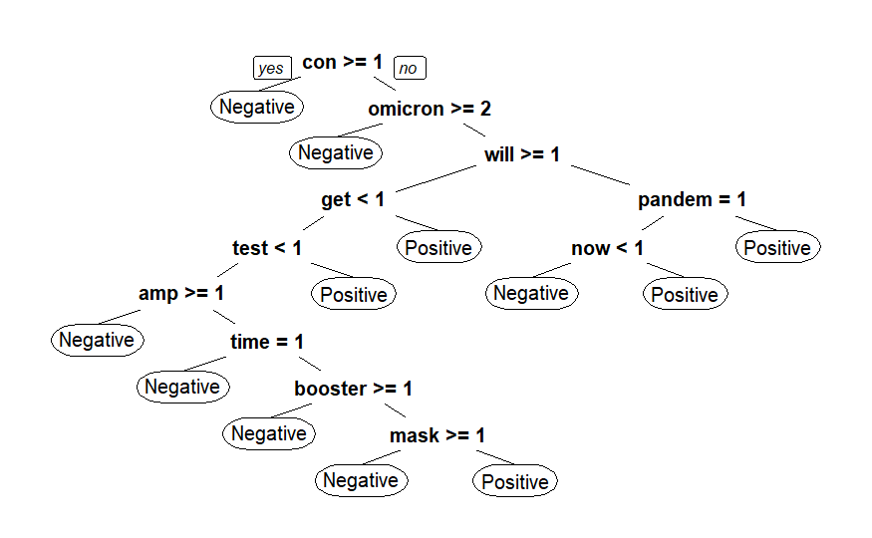
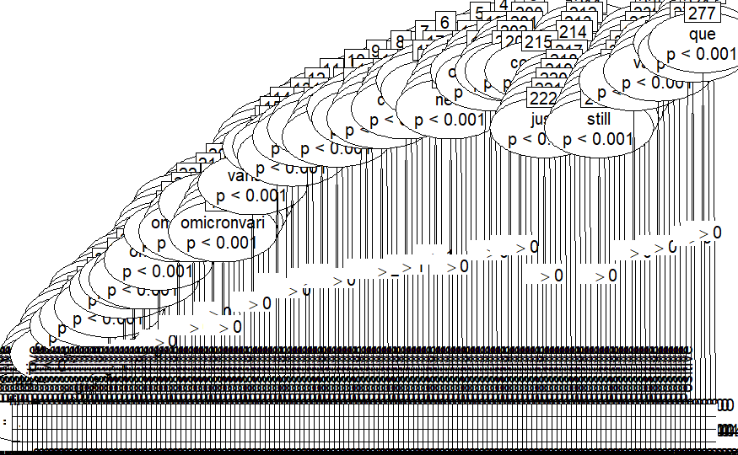
Decision Tree- Rpart
Decision Tree- Ctree

Slide 16
Predict the test data by using the trained model
Predictions were made to observe positive or negative sentiment of the covid19 tweets
Created confusion matrix
Calculated Accuracy
Association Rules
Convert the data frame into transactions for predicting the product relation
Used Apriori Algorithm to find the association between the words
1044 rules were formed. Minimum and maximum values for support, confidence and lift are displayed
Out of the 1044 rules formed the counts of rule length is also displayed
Predicted the product relation

Slide 17
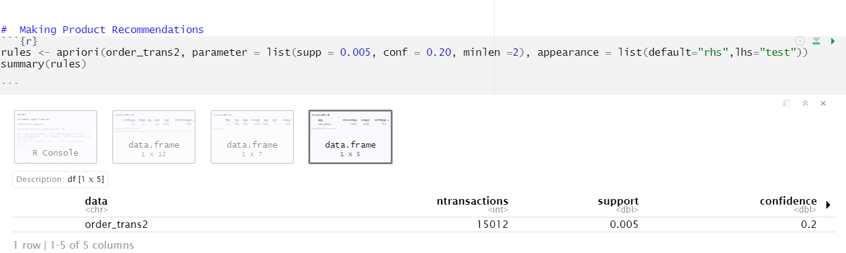
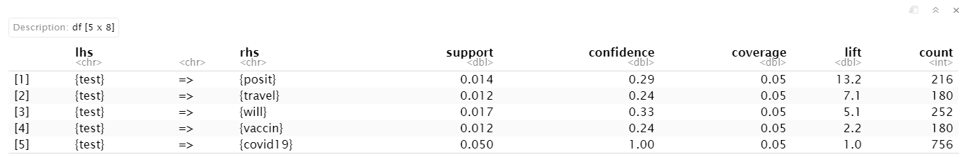
Results
Input data
Classification Models | Accuracy(%)
Logistic Regression | 81.08
Decision Tree(Ctree) | 94.07
Decision Tree(Rpart) | 80.91
Naïve Bayes | 77.45
Output data

Slide 18
Conclusion
Our models will try to predict the sentiments as Positive or Negative Tweet
We have used various models for training our dataset but some models show greater accuracy while some do not.
For binary classification, the best model for this dataset would be Decision Tree-Ctree because it achieved higher accuracy than other models
Decision Tree – Ctree Accuracy: 94.07%
Association Rules- The top product recommendation for people who took covid test as negative will travel and vaccinated
Association rules are used extensively in a variety of fields. We have also seen how Association rules analysis can done with the help of the Apriori algorithm. This is quite helpful in getting product recommendations for customers. So, go ahead and start mining your own datasets.

Slide 19
Text analytics can deal with the massive amounts of unstructured data being generated on the internet
Computers are becoming more and more capable of interacting with humans and performing human tasks
We can explore more from textual data and tweets for further research

Slide 20
Thank you
Any Queries?

